Slide 1
StudentMania
Discord for Students
By
Jack Haugh G00359747
Kevin Flanagan G00228079
Stephen Gallagher G00314689

Slide 2
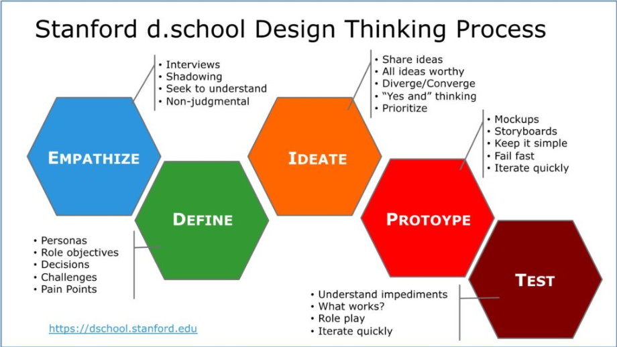

Slide 3
Objectives Goals for overall Project
Website for Students – place to go for resources/help –a students go to Application!
Share content & files
Chat with other students for different purposes :
Let people know of changes (eg: Timetable/exams)
Video call (Improve Communication)
Keep Students on top of there classes and not fall behind

Slide 4
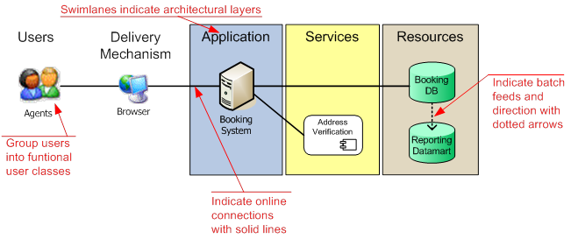
Architecture
How its built!

Slide 5
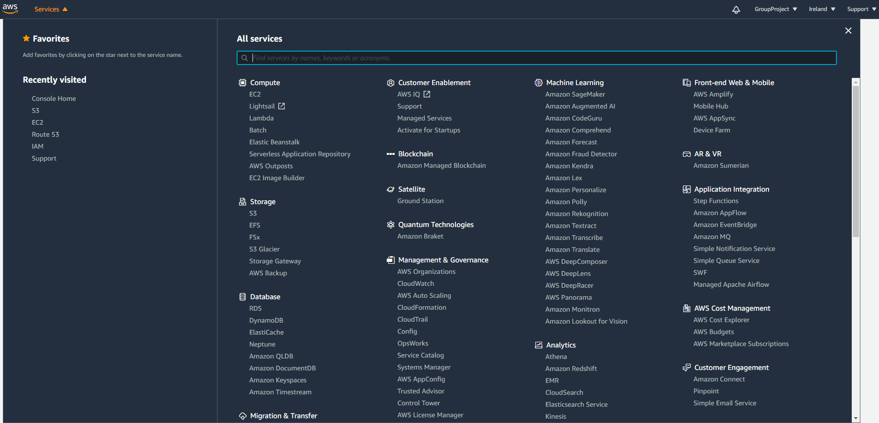
AWS Cloud Web Services

Slide 6
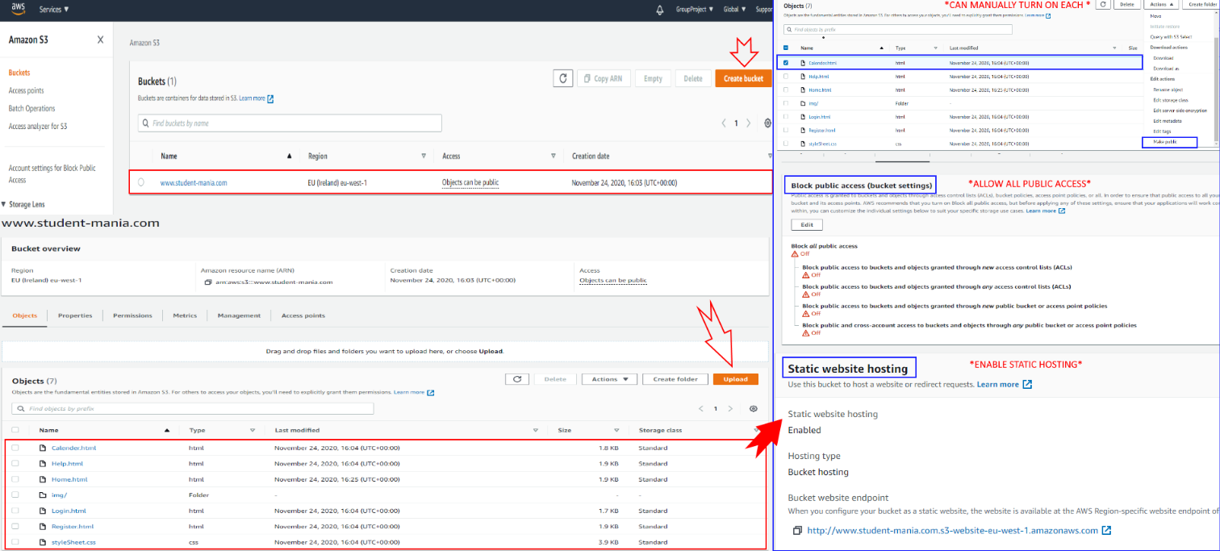
S3 Bucket Storing Website

Slide 7

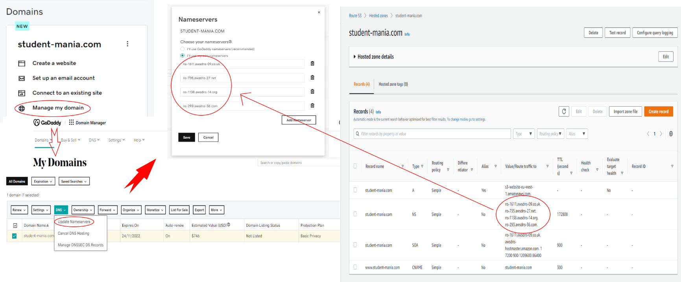
Route 53 Linking Website Bucket to custom GoDaddy Domain

Slide 8

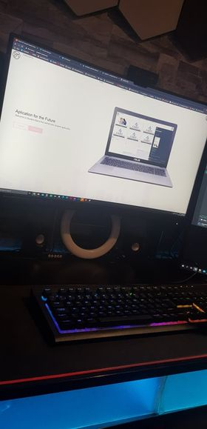
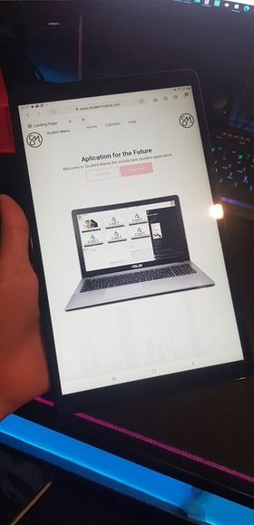
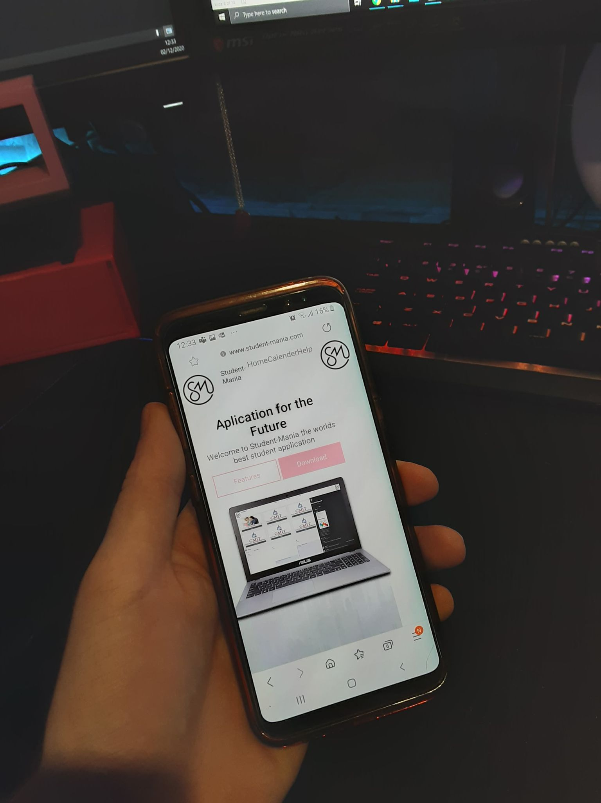
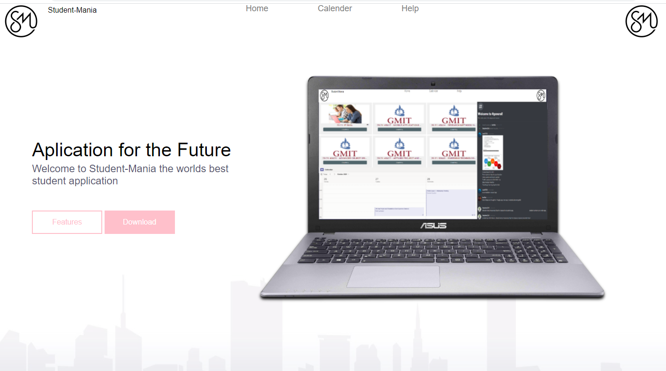
www.Student-Mania.com
Computer
Tablet
Mobile

Slide 9
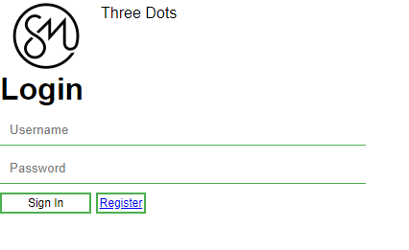
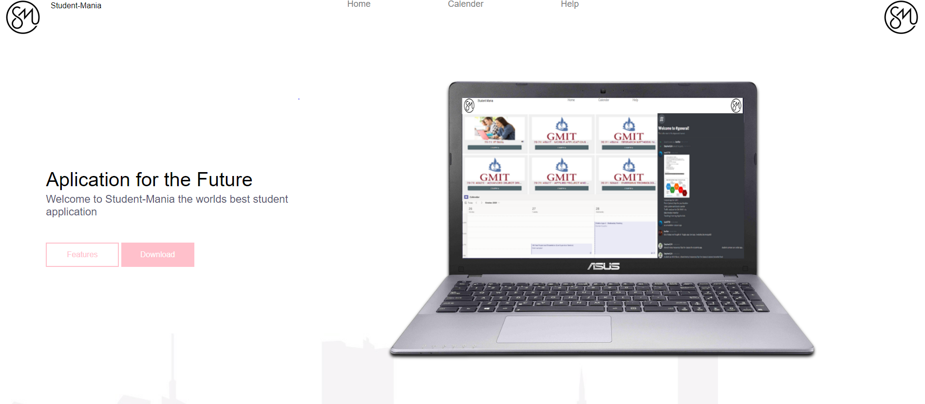
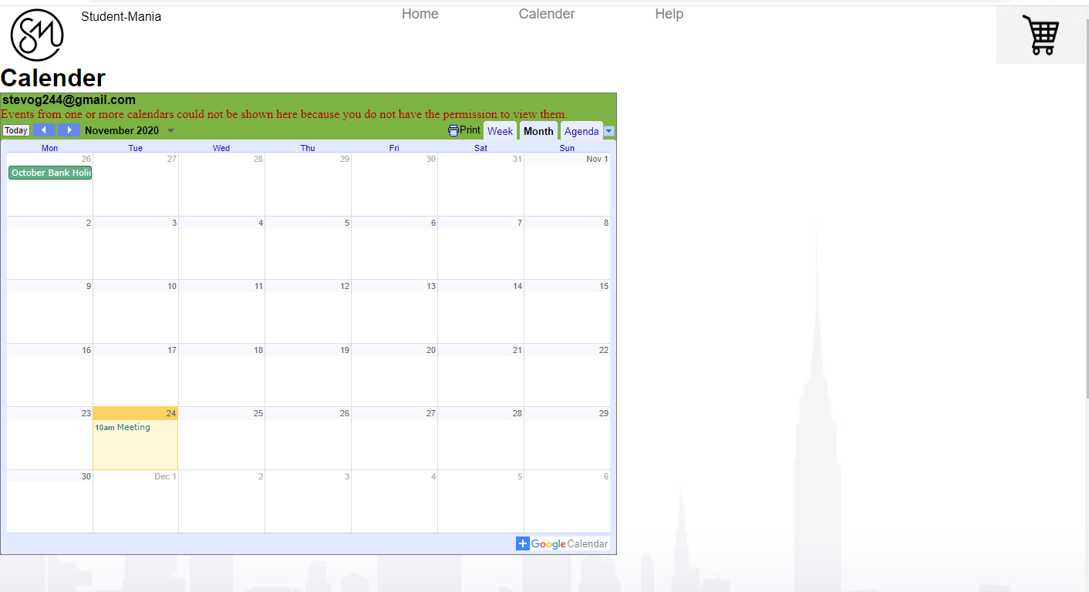
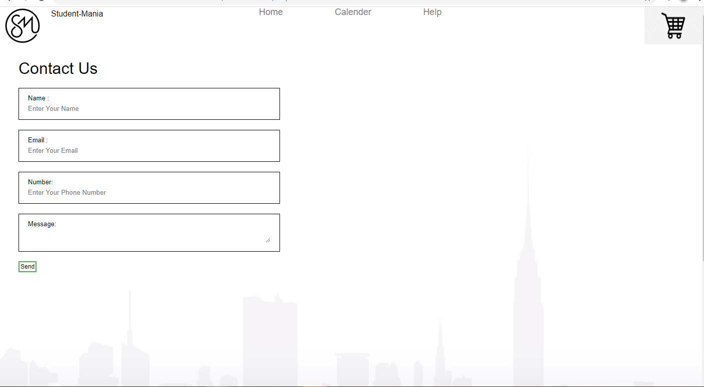
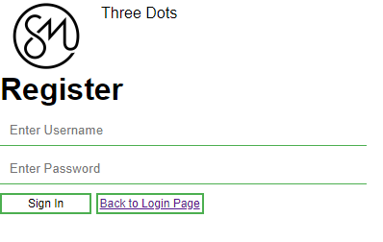
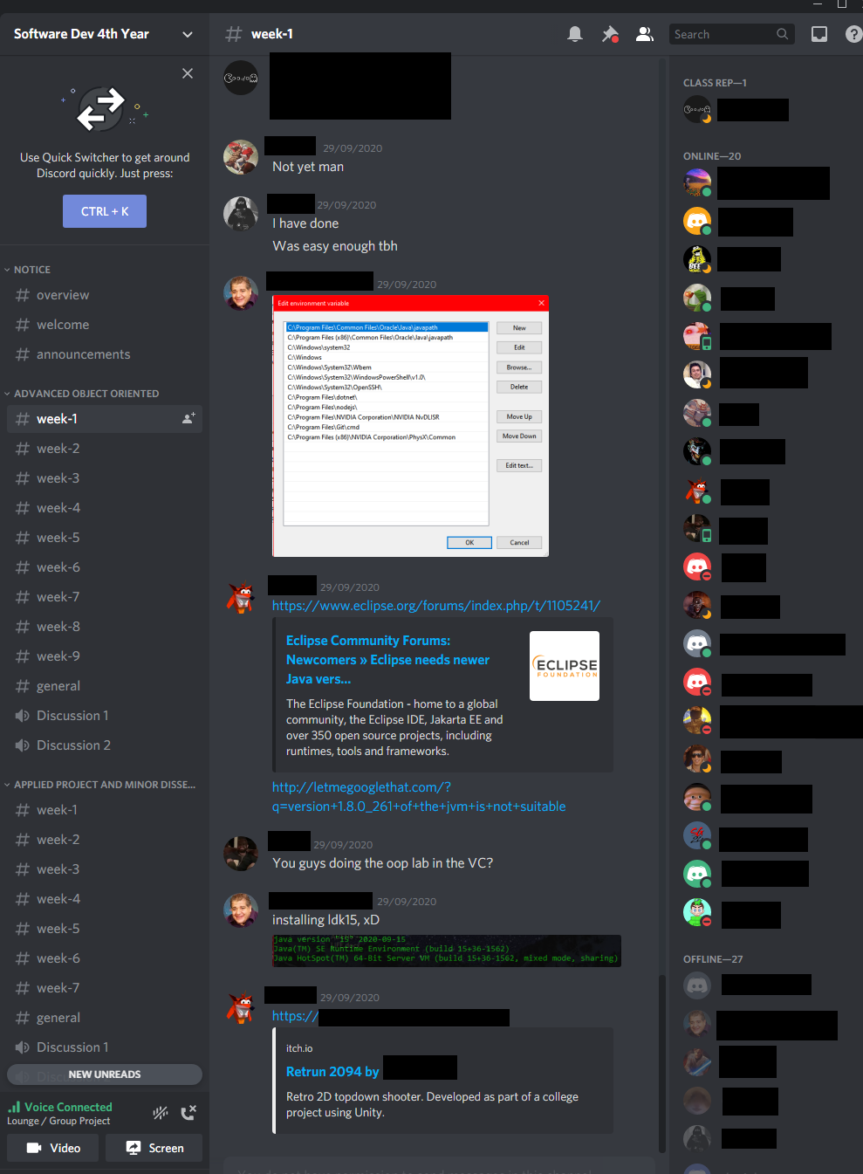
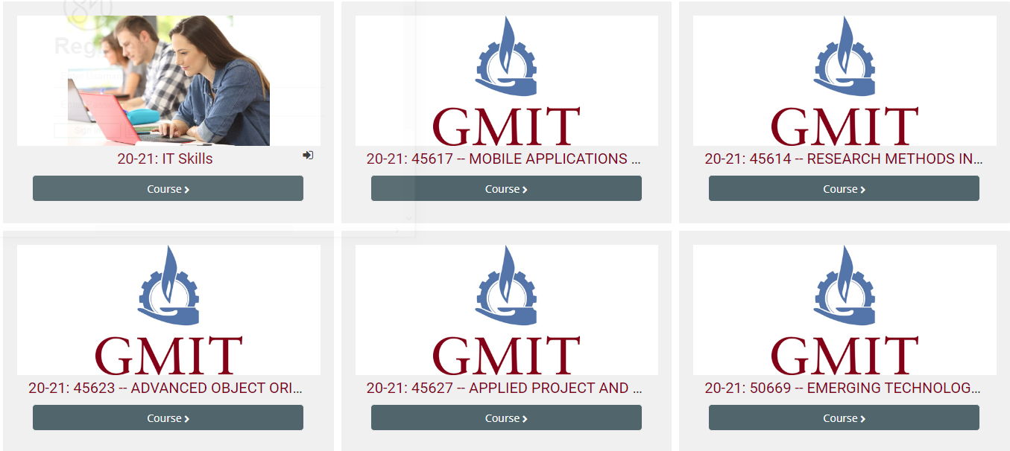
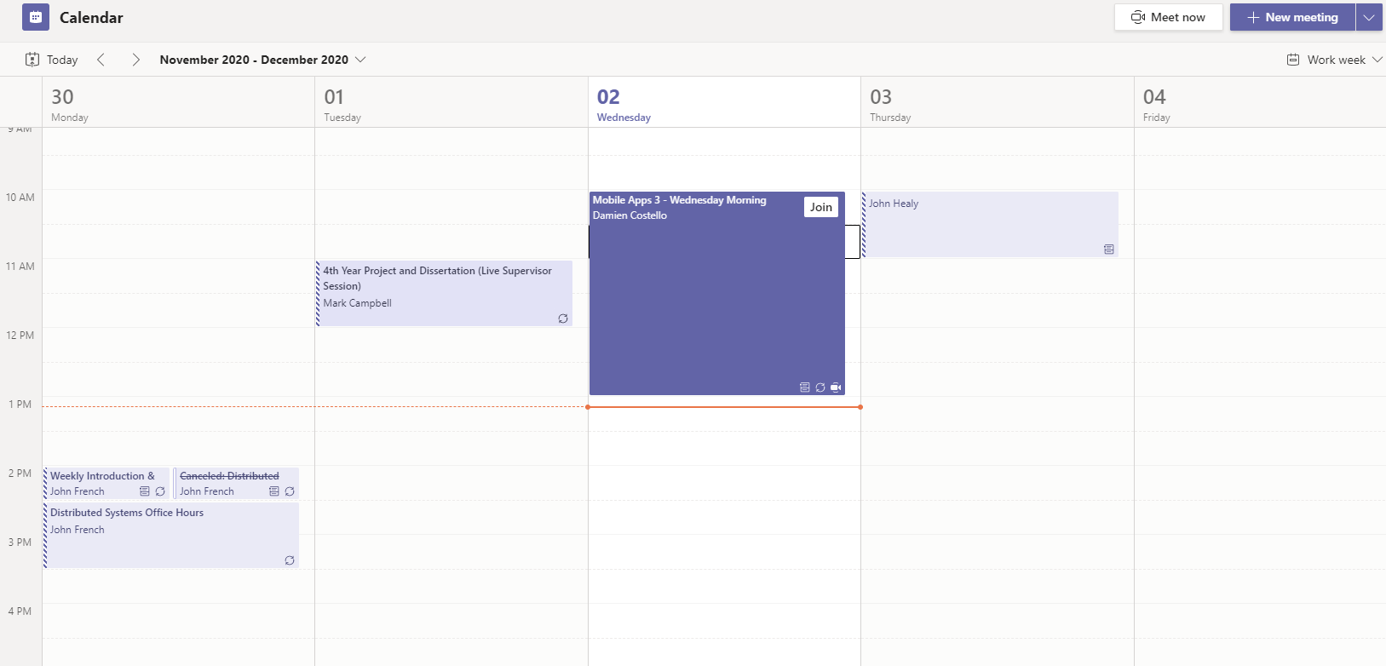
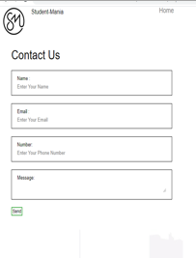
Website Pages
NOW
Login/Register
Home
Calendar Page
Help /Contact Page
GOAL
Login/Register
Home
Modules Page
Calendar Page
Chat Page
Help/Contact Page

Slide 10
Plan for semester 2
Login – functioning login
Modules for student – students having there own section for each of there modules
Chatbox – Getting communication between users in real time
Video- allowing users to be able to Video call one another

Slide 11
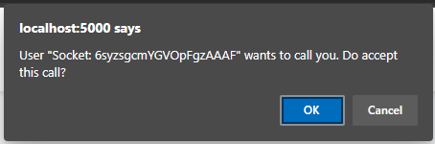
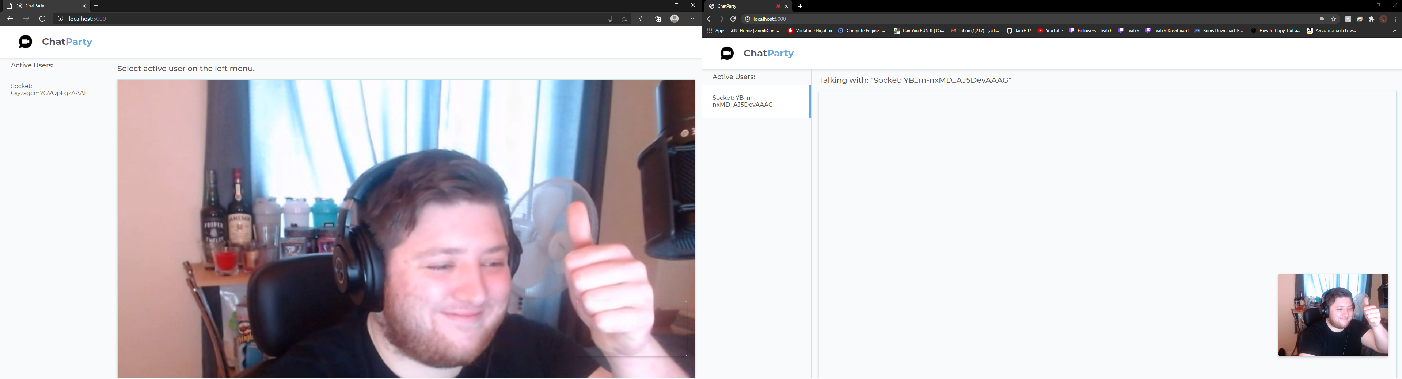
Video and audio – Web RTC

Slide 12
Demo of the prototype
Link to website!
Show it off!

